Slide 1
LESSON 1
Summer jobs

Slide 2
Looking for / understanding and replying to job advertisements
Aims:
to learn to use the Internet in a purposeful and effective way
to become familiar with the vocabulary used in job adverisements, especially features of character, types of jobs and abbreviations
to practise writing and replying to job advertisements
to prepare to written matura exam

Slide 3
These abbreviations often appear in job advertisements:
Asap ref. no. p.a. pro rata p/w neg. inc. k c s.a.e.
Match the abbreviation from the list on the right, with its definition on the left
1. per week A (ref. no)
2. thousand B (inc.)
3. negotiable C (k)
4. reference number D (p/w)
5. per annum, yearly E (pro rata)
6. stamped addressed envelope F (neg)
7. as soon as possible G (c.)
8. approximately H (asap)
9. inclusive I (s.a.e.)
10. according to time worked J (p.a)

Slide 4

Find the opposites
full-time job -
temporary job -
employer –
menial –
skilled –
white-collar worker -
shift work –
wage –
Find examples of different features of character that are of importance to employers

Slide 5
LESSON 2
Crosswords

Slide 6
Aims:
to revise vocabulary from the previous lesson / unit
to use online english dictionaries
to revise relative pronouns
1. In pairs or groups of three students choose 10 words from the previous lesson / unit.
2. They write definitions of these words (in English). If it’s necessary they can use online English-English dictionary e.g. http://dictionary.cambridge.org/ or http://www.macmillandictionary.com/
3. Next, they create a crossword by the means of free online crossword puzzle makers, e.g. http://www.armoredpenguin.com/crossword/
4. Students exchange their crosswords and solve them.

Slide 7
Lesson 3
Movie dubbing

Slide 8
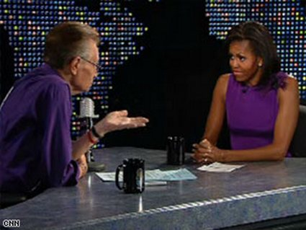

Dubbing – clips, movie scenes without sound
Aims:
to practise a specific grammar structure, e.g.
First date – dialogue with question tags
- I’ve never been to Paris, have you? - No, I haven’t. Maybe we could go there together one day, couldn’t we? - Yes, it seems to be a great idea, doesn’t it? - Yes, it does but there’s a tiny little problem. I don’t have a passport, …?
TV interview – Present Perfect vs. Past Simple
- Have you ever done something illegal?
- Yes, I have.
- What did you do?
- I once …

Slide 9
Dubbing
- to practice specific vocabulary, e.g.
At the doctor’s
At the court
Dialogue in a shop – making a complaint
At a job interview
At the airport
etc.

Slide 10

Clip suggestions

Slide 11
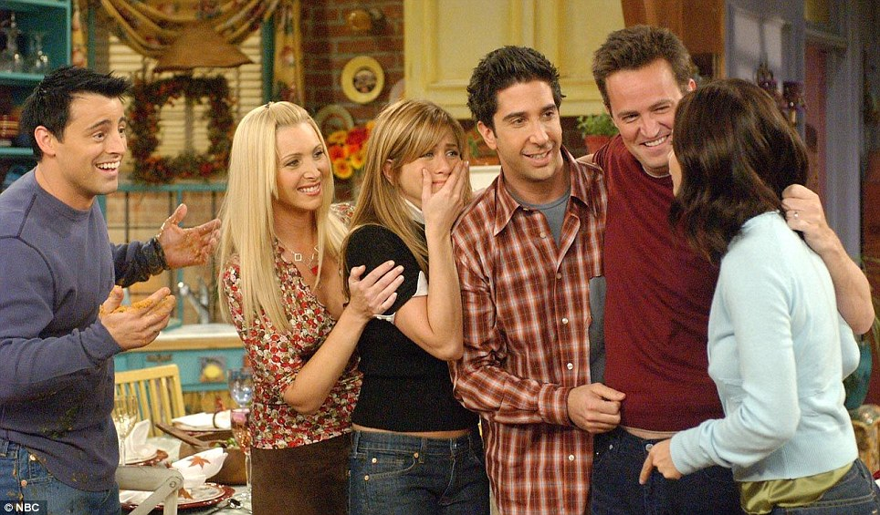

Friends

Slide 12


Suits

Slide 13
LESSON 4
Self-generated oral matura exam activities

Slide 14
Aims:
to prepare to oral matura exam
to practise speaking, giving opinions, justyfications, agreeing, disagreeing, negotiating and finding a compomise
to enable students to work on materials which are relavant to them
to use the Internet for finding pictures
to use online dictionary
to cooperate in groups
to practise specific vocabulary (connected with one of the matura topics)
to practise question forms
to pactise predicting and making connections

Slide 15
Situation 1
You’re just about to meet your future parents-in-law for the first time and you want to take them to a restaurant. Together with your wife-to-be decide which place would be the most suitable for this occasion. Justify your choice.

Slide 16
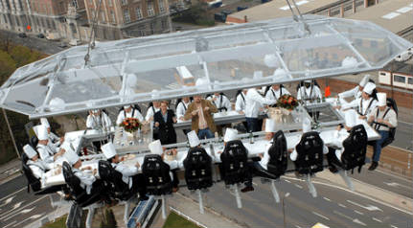
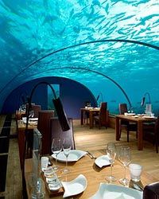
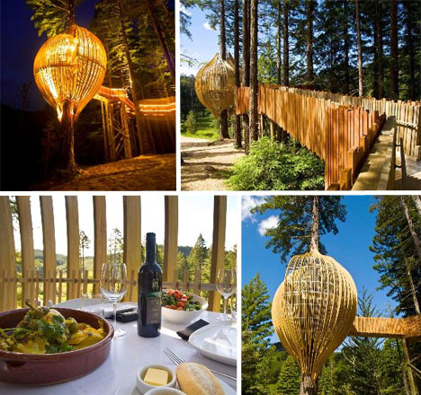
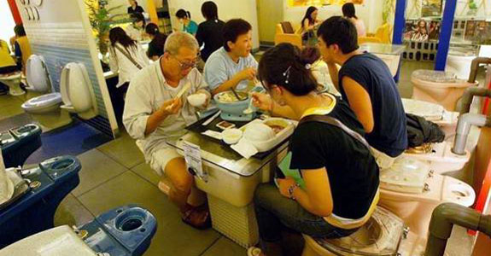

Slide 17
Questions
What are the features of a good restaurant?
2. What qualities are needed in order to run a restaurant?
3. Should cooking be an obligatory school subject?
4. What makes cooking shows on TV so popular?

Slide 18
Situation 2
You‘re a freshman and you’ve just moved into a dormitory. Together with your roommate you have to choose paintings to decorate your room. You have to reach a compromise and remember to justify your choice by providing at least three arguments.

Slide 19
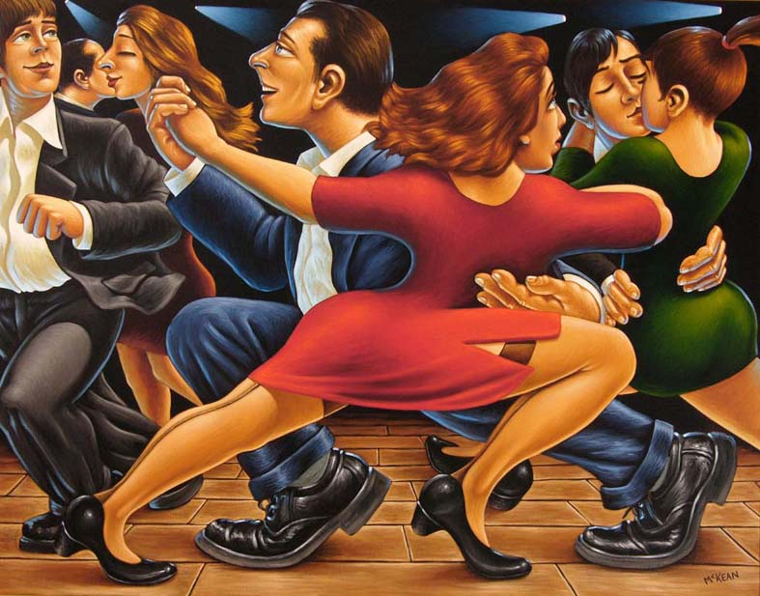

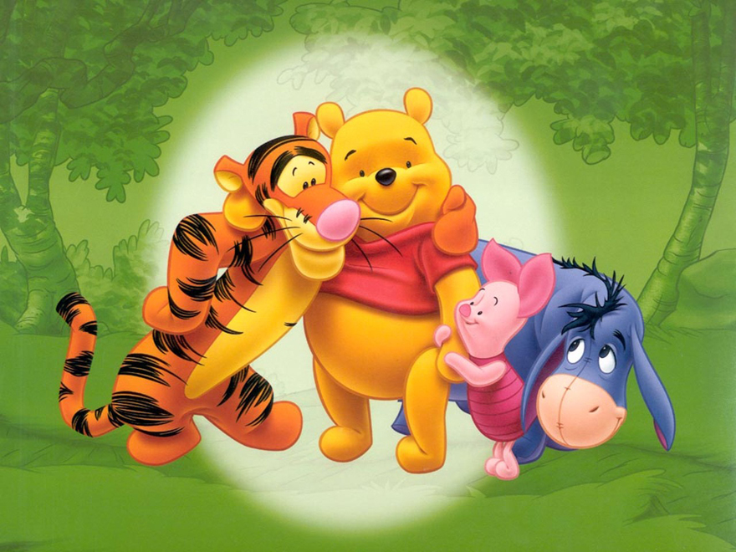
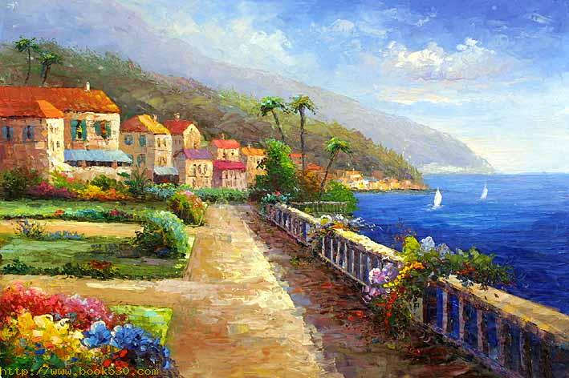
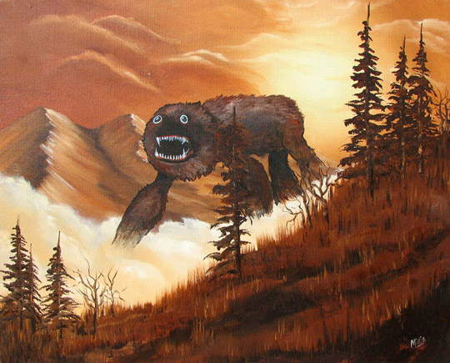

Slide 20
Questions
Do you enjoy going to art galleries? Why / why not?
Is street art real art in your opinion? Why / why not?
Do you think art should reflect social issues? Why / why not?
What sort of things are a source of inspiration to artists?

Slide 21
Other Suggestions

Slide 22
News
Commercials
Organising holidays

