Slide 1
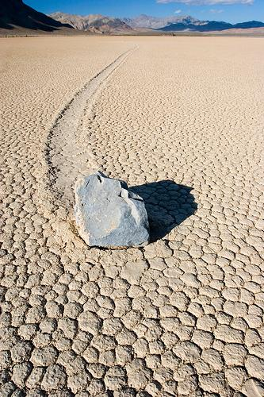
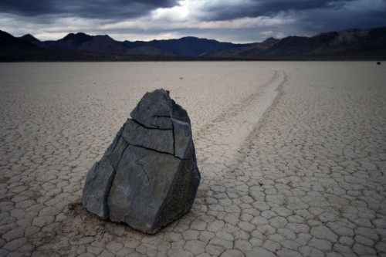
Sailing Stones

Slide 2

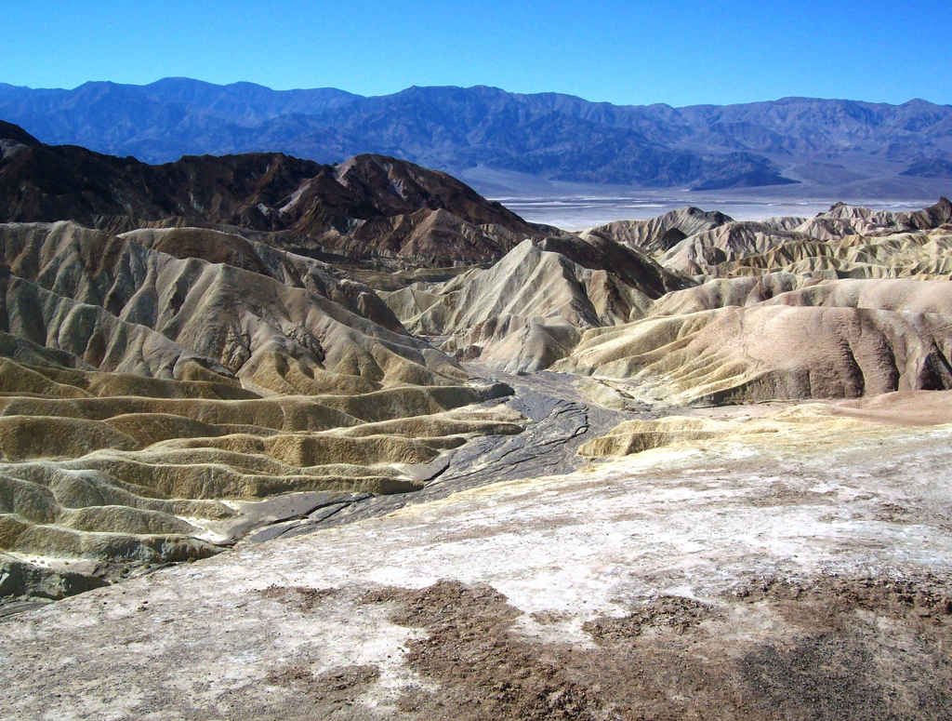
What is it?
Geological phenomenon that can be observed in dried-up lake of Racetrack Playa (in Death Valley)

Slide 3

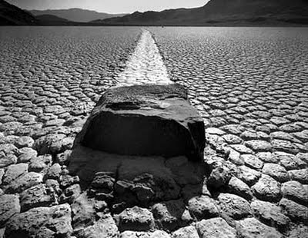
How does it work?
The stones move along the surface, leaving behind long traces.
The stones are moving in winter only, but it doesn’t happen every year.
Their traces are visible for a few years.

Slide 4

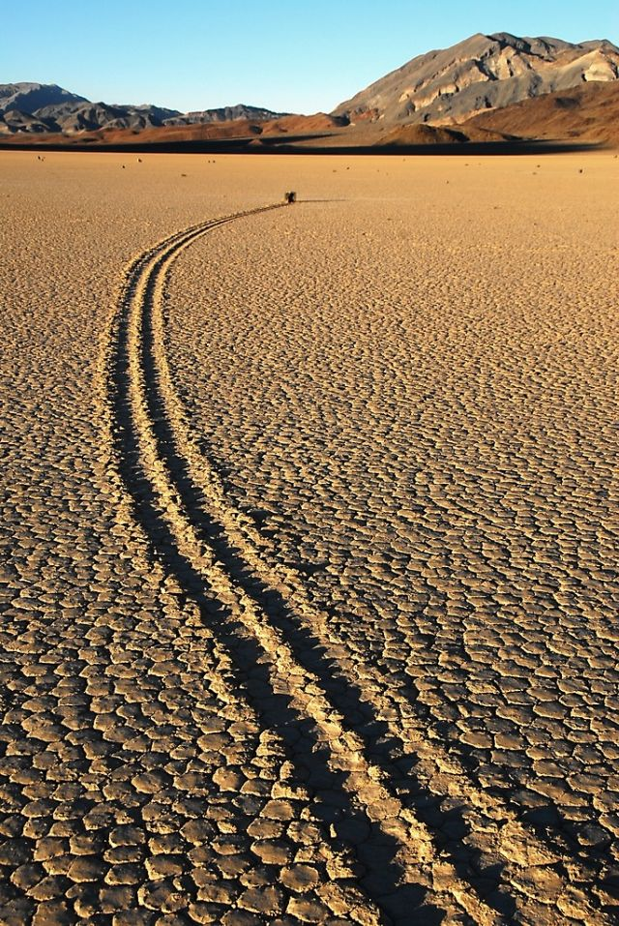
How long are their traces?
Traces have got different lengths from a few to several meters.
The longest trail had 201 meter. meters !

Slide 5
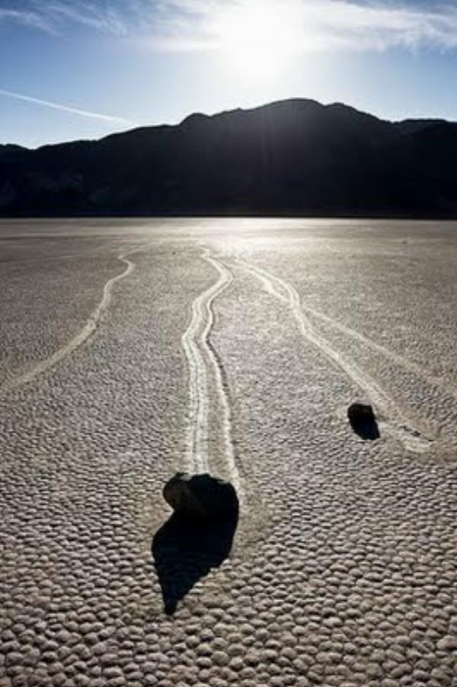
How is it possible that they are moving?
Geologists think that this is due to wind and mud but wind can’t move stones which weight as much as human.
Some people think that this happens because of freezing water at night in winter, which creates ice sheets. Widespread winds in Death Valley are able to move the stones.

Slide 6


Nobody has seen moving stones and cameras haven’t registered it yet.

Slide 7
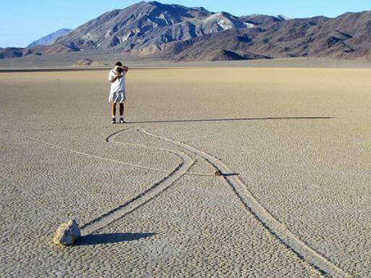
Why is it so amazing?
Stones are moving parallel and suddenly one of them changes the direction of movement.

Slide 8






What makes them move?
No one can answer this question.

Slide 9
Sandra Żyła class 2b

