Slide 1
English dialogues
Listen – write – talk
Three steps – three lessons

Slide 2
Participating: Students from school year 9
Hässelbygårdsskolan
Stockholm
Sweden

Slide 3
The Swedish national curriculum emphasizes the skills on how to use spoken English when interacting with other people.

Slide 4
Students should be given many opportunities to develop skills to:
Understand spoken English
Express themselves and communicate in English
Use different strategies to make themselves understood
Adapt the use of English in different situations and for different purposes

Slide 5
Lesson 1 First step
The students evaluate their own abilities on a five grade scale:
”How well can I…”
ask and tell the time
tell the days of the week
use question words
use prepositions

Slide 6
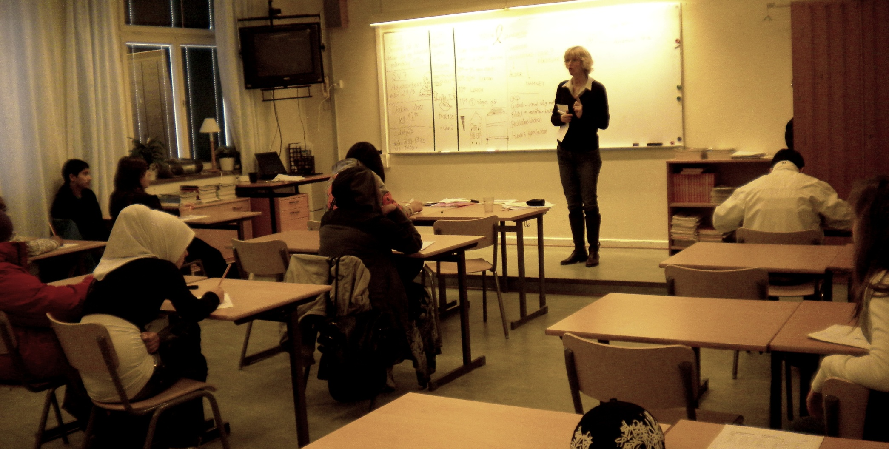
Lesson 1 Second step
The teacher goes through how to ask and tell the time, weekdays, prepositions and question words on the white board and the students take notes.

Slide 7
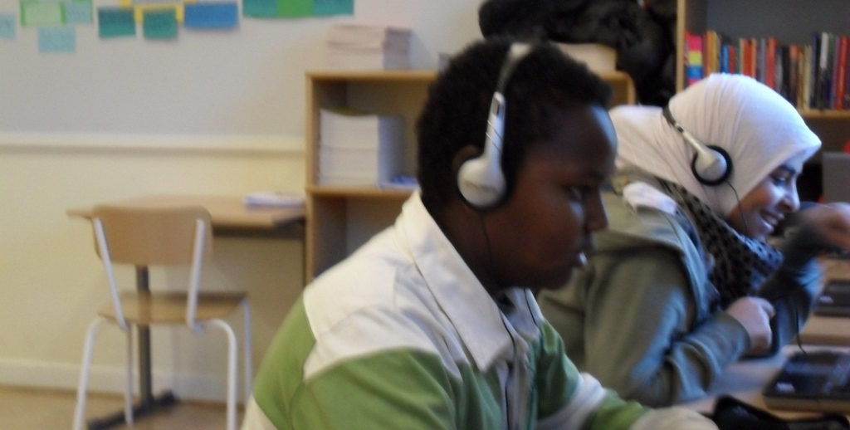
Lesson 1 Third step
The students listen to different dialogues from www.talkenglish.com in order to practise their listening skills

Slide 8
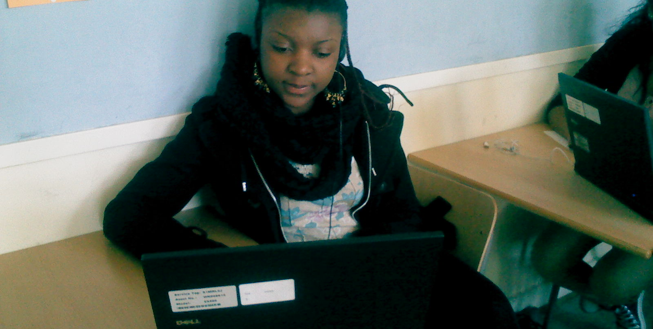
There are three different levels for the dialogues: basic, intermediate and advanced.

Slide 9
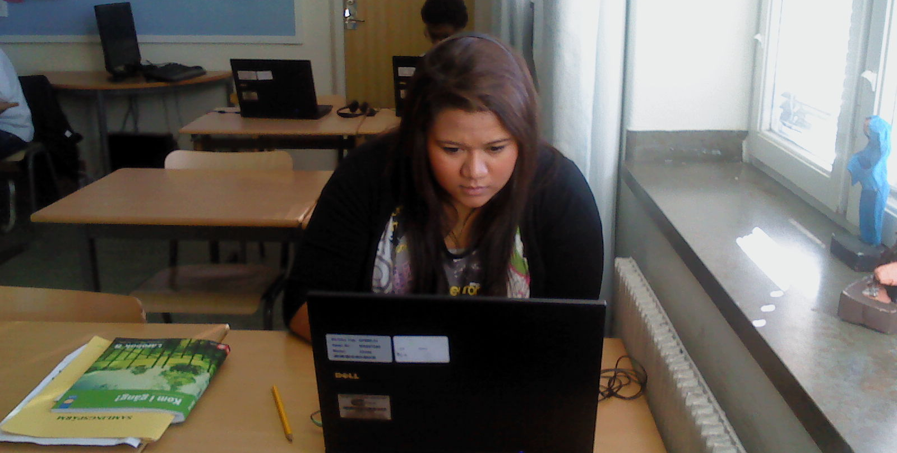
They can choose from more than thirty different dialogues on each level.

Slide 10
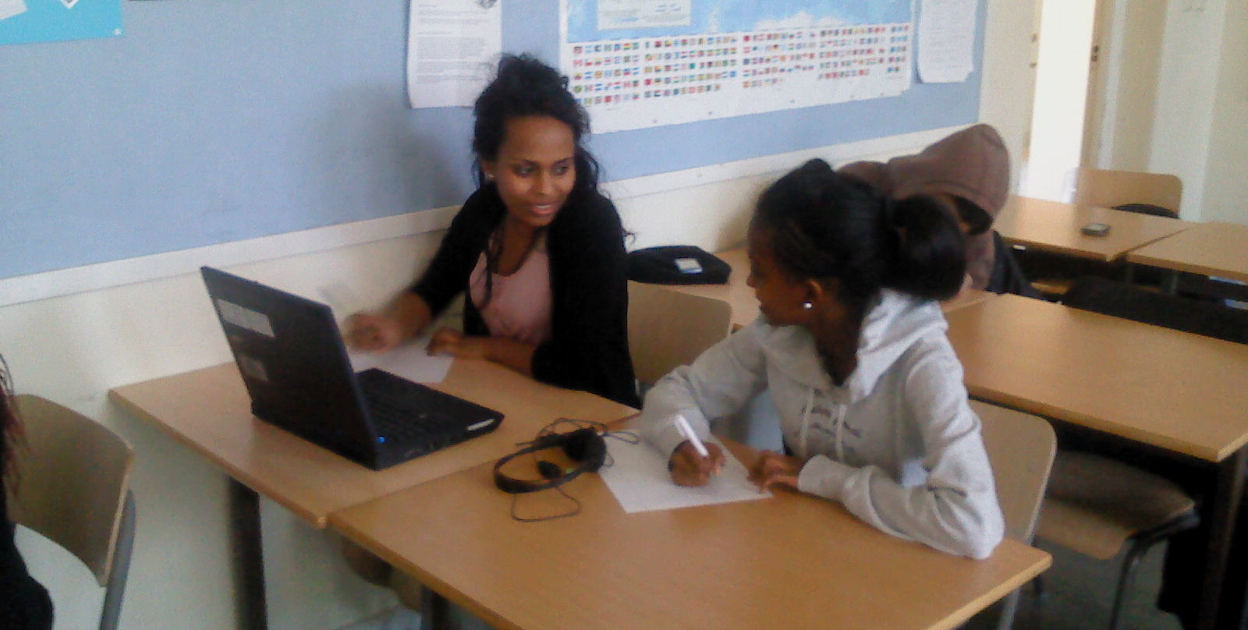
Lesson 2 Step 1
The students work in pairs and write their own dialogues based on what they learned during lesson 1.

Slide 11
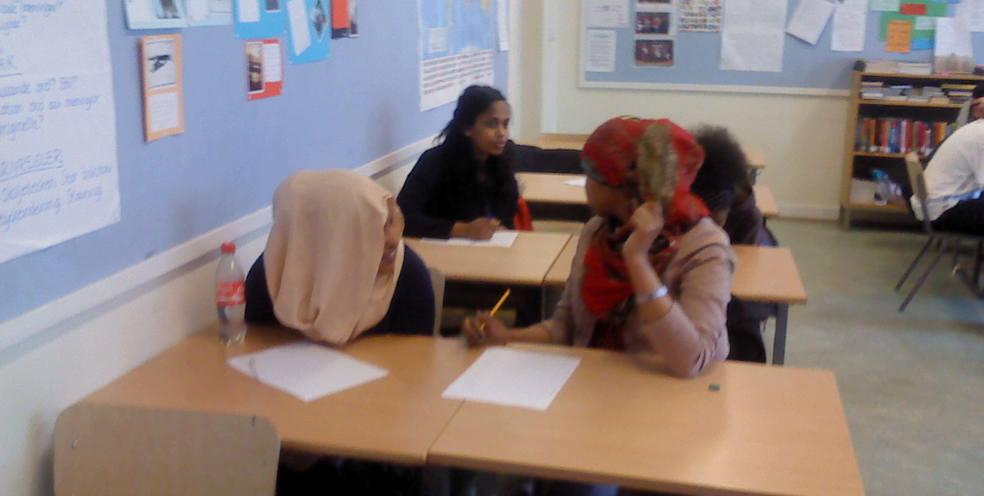
They write about how to make appointments.

Slide 12
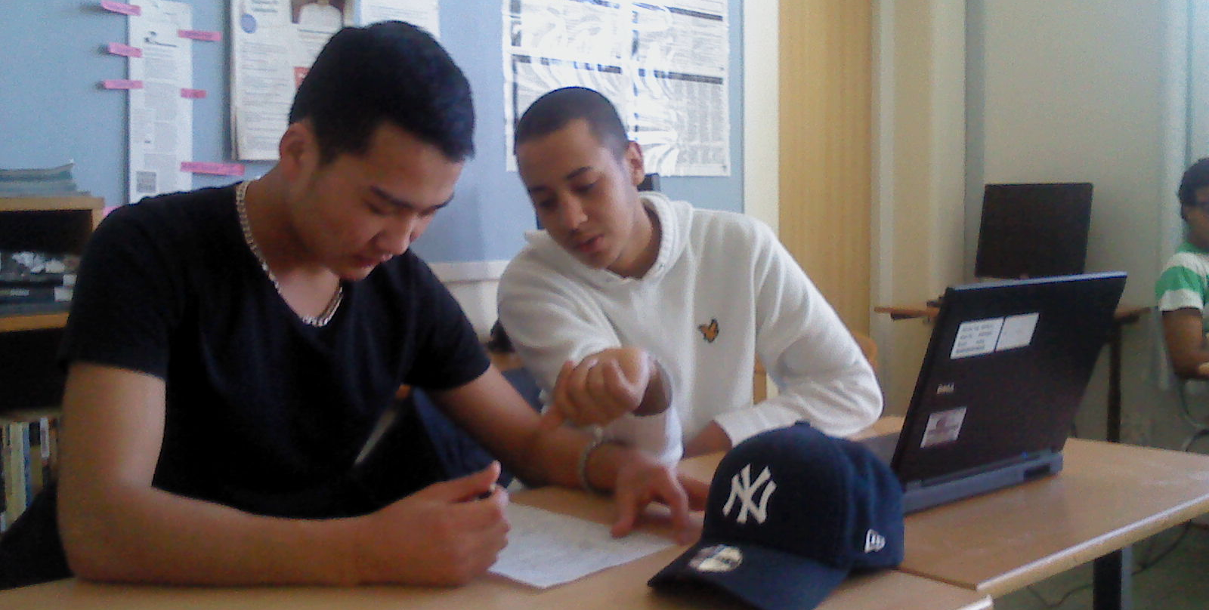
They are instructed to use different words and expressions for telling the time.

Slide 13
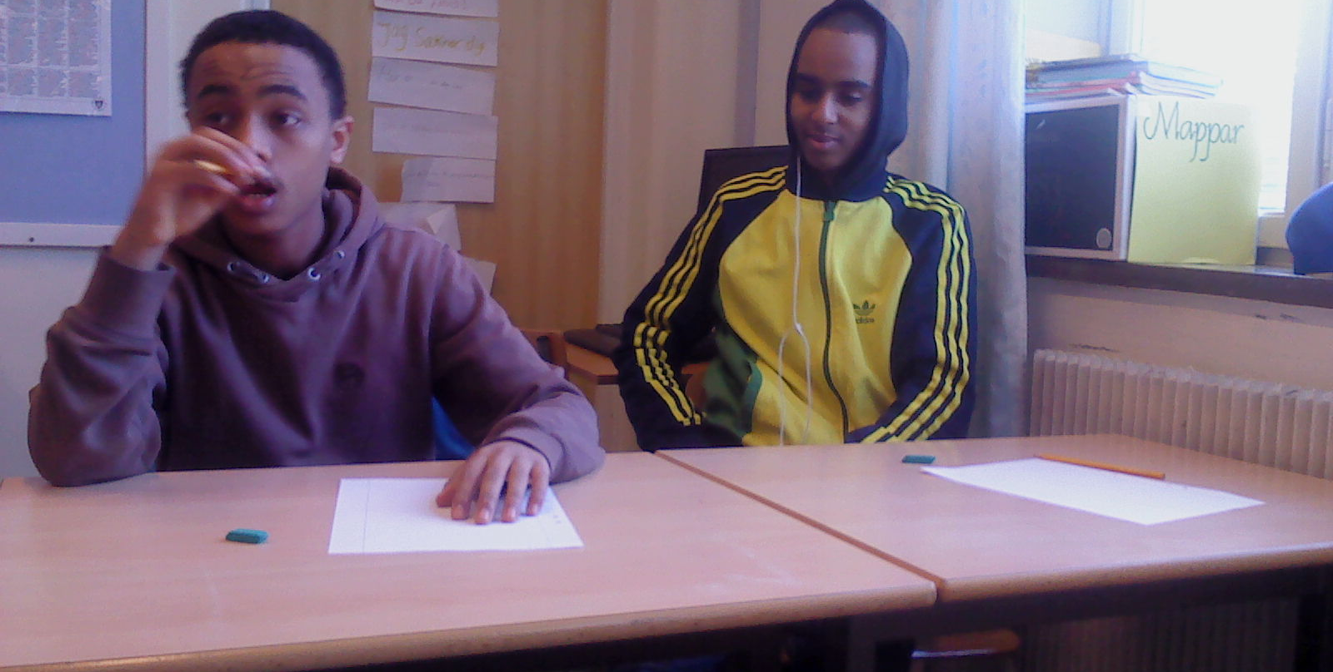
They are instructed to use different question words.

Slide 14
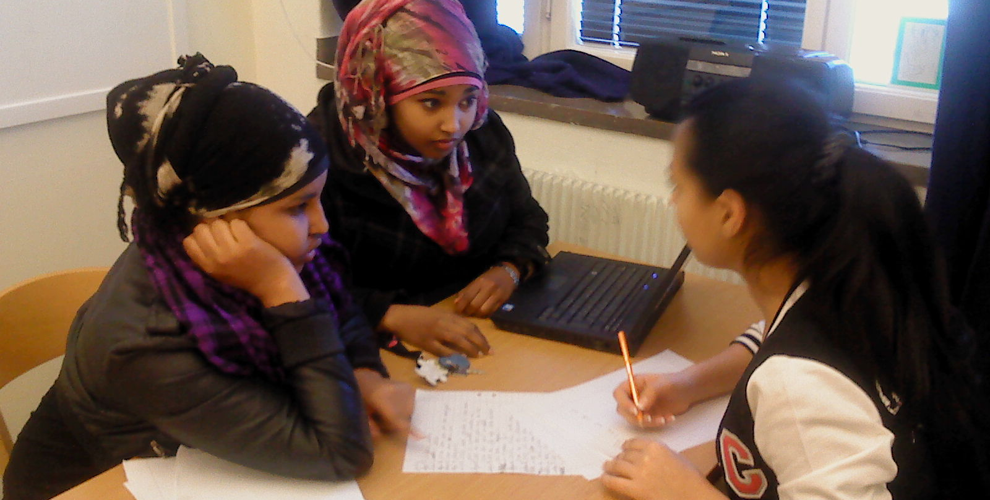
Lesson 2 Step 2
The students practise reading their dialogues many times to get the pronunciation right.

Slide 15
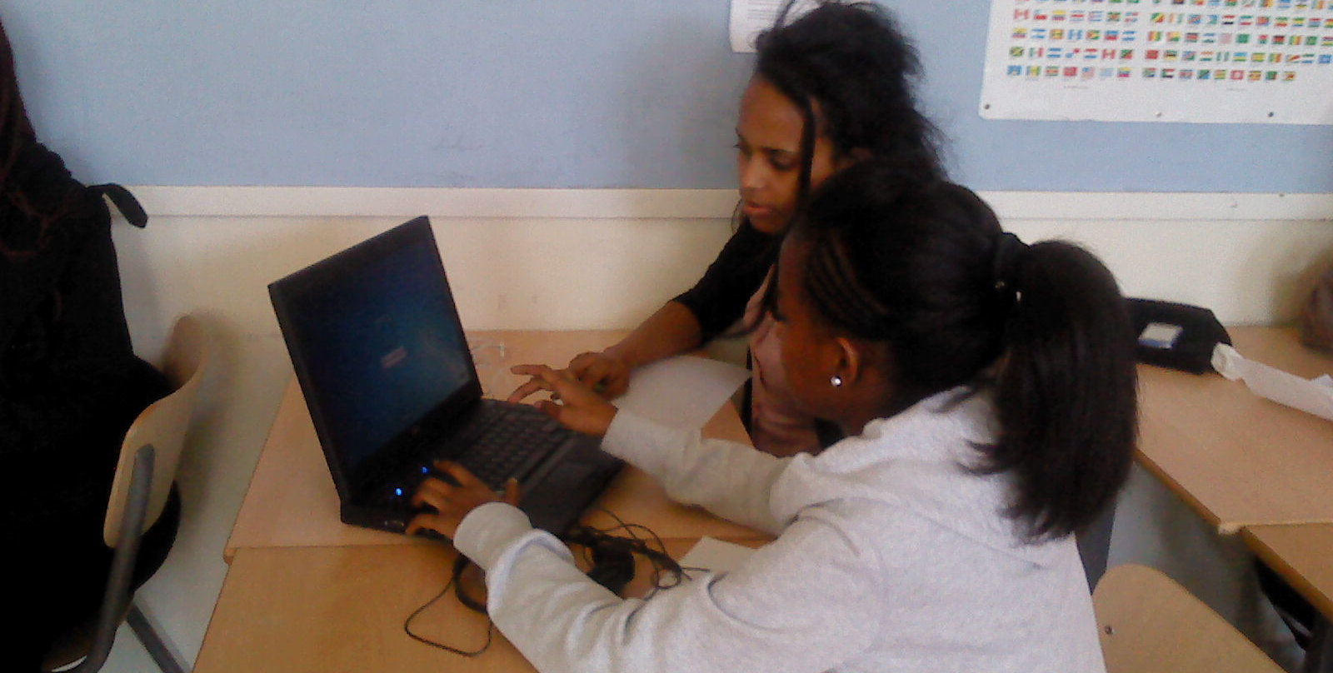

Lesson 3 Step 1
The students start recording their dialogues.

Slide 16
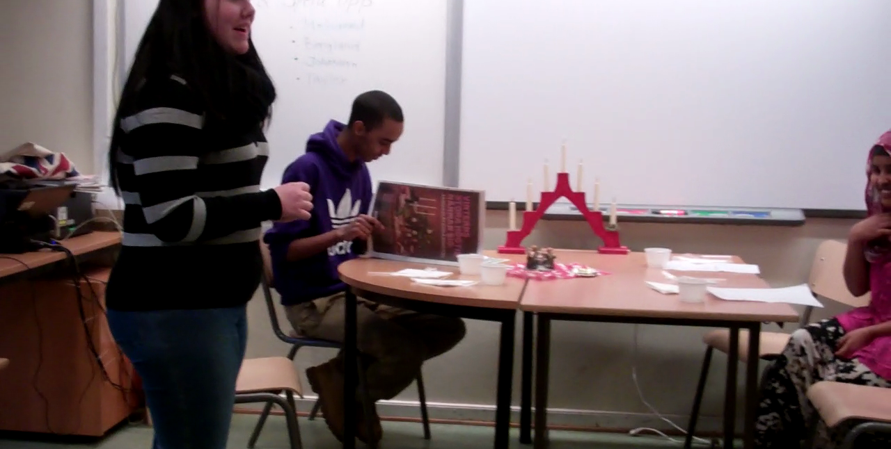
Lesson 3 Step 2
Some students practise and then perform their dialogues in front of the class.

Slide 17
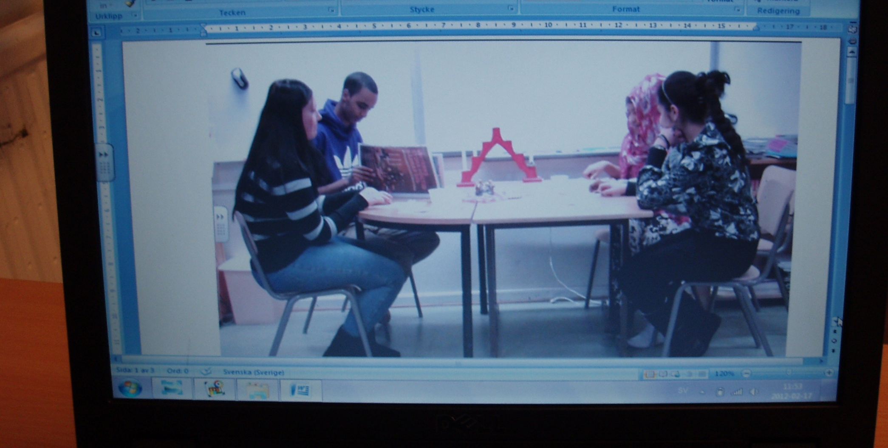
The teacher documents the students´ demonstrations by filming them.

Slide 18
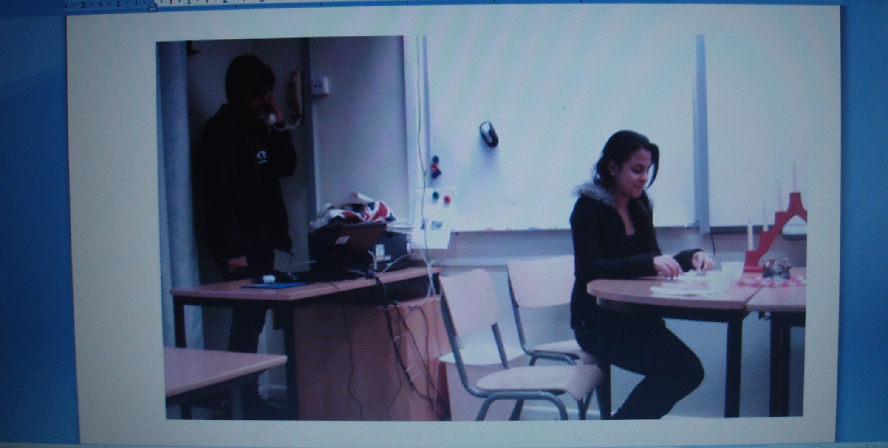
The films will be shown in class later on and are to be evaluated by themselves as well as other students.

Slide 19
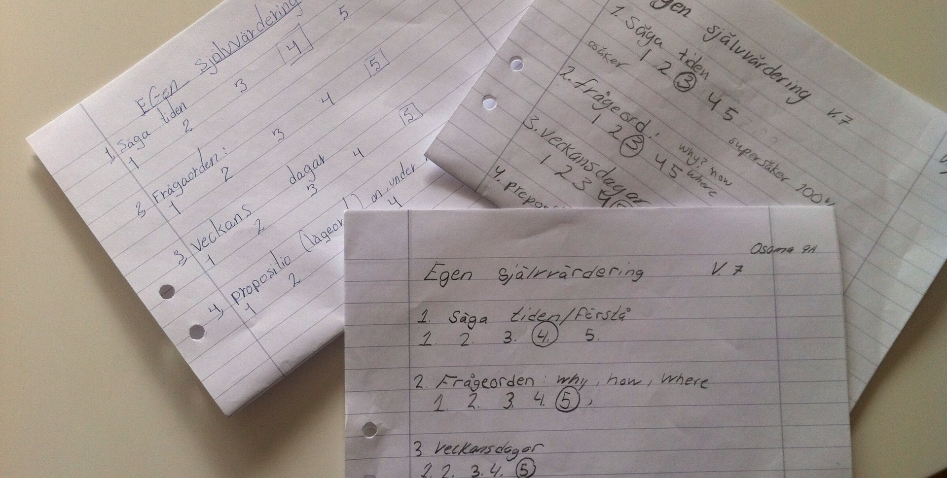
Lesson 3 Step 3
The students complete the same evaluations as in lesson 1.

